Slide 1
DAC-006
Introduction to NLP
Lesson 1

Slide 2
01
INTRODUCTION
A brief overview of Natural Language Processing (NLP)

Slide 3
SO, WHAT IS NLP ANYWAYS?
Natural Language - any language that has evolved naturally in humans through use and repetition without conscious planning
e.g. speech, written text
vs. formal mathematical notation, coding languages
Natural Language Processing - the application of computational techniques to the processing, analysis and synthesis of natural language
e.g. translation, question answering, speech recognition
Different levels of NLP applications
Notes:
Natural Language (NL)
Definition: Any language that has evolved naturally among humans through use and repetition.
Examples: Spoken language, written text, emails, chats.
Contrast: Different from formal languages like:
Mathematical notation
Programming languages
"Natural language is often ambiguous, context-dependent, and variable, which makes it challenging for computers to understand directly."
🗣️ Natural Language Processing (NLP)
Definition: Application of computational techniques to process, analyze, and synthesize natural language.
Purpose: Enable machines to understand, interpret, and generate human language.
Examples of NLP Applications:
Translation (Google Translate)
Question Answering (Chatbots, virtual assistants)
Speech Recognition (Siri, Alexa)

Slide 4
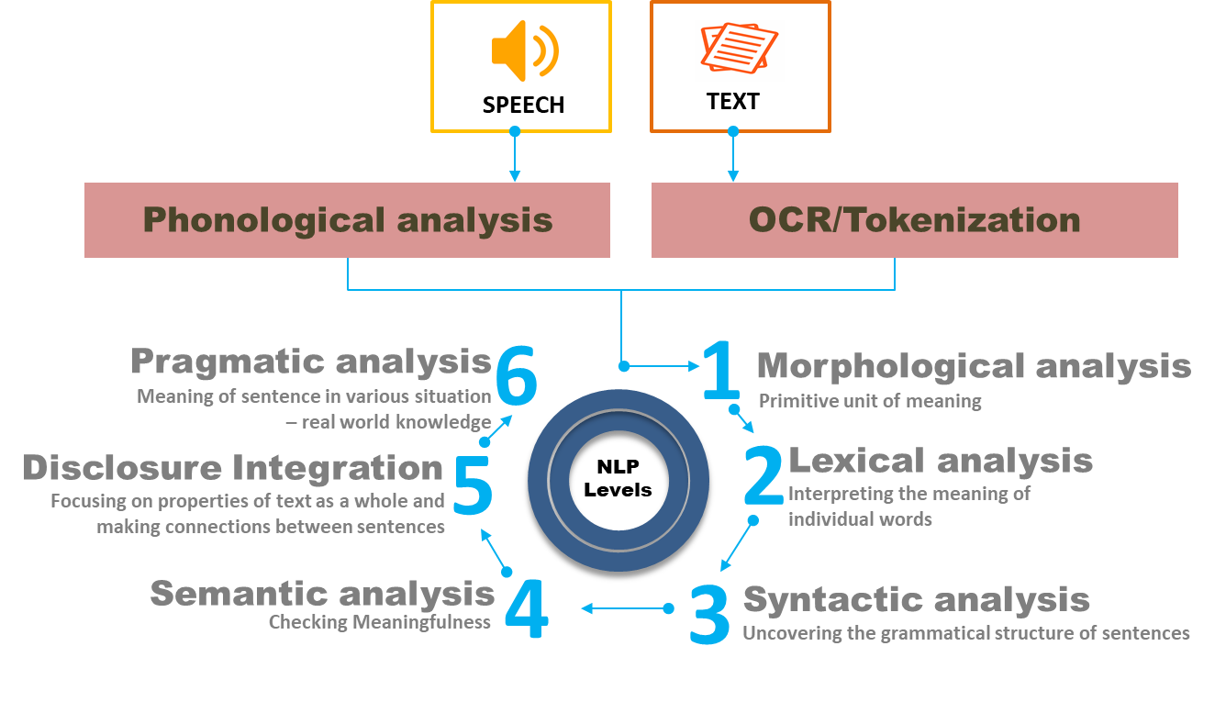
DIFFERENT LEVELS OF NLP
Source: https://datascience.foundation/sciencewhitepaper/natural-language-processing-nlp-simplified-a-step-by-step-guide
Notes:
Different Levels of NLP Applications
Lexical Level – Words and their meanings
Syntactic Level – Grammar and sentence structure
Semantic Level – Meaning of sentences and context
Pragmatic Level – Understanding intent in conversations
Discourse Level – Relationships across multiple sentences

Slide 5
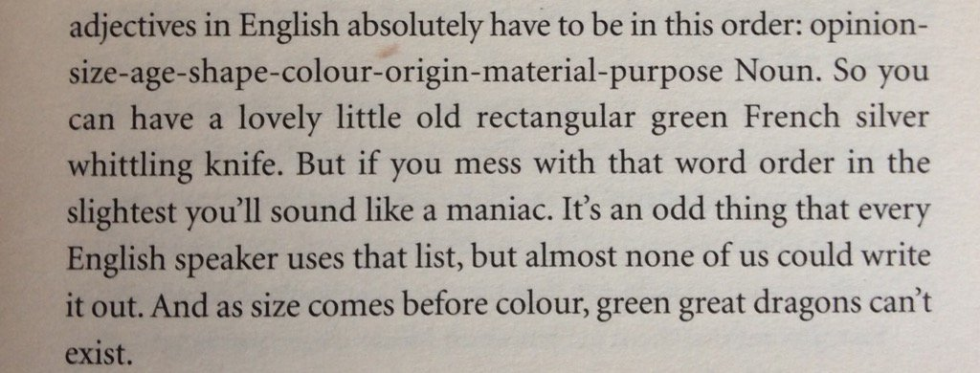
WHAT MAKES NLP HARD?
The Challenge - Being able to ‘teach’ a machine to understand the complexities and subtleties of human language. Some things to ponder:
How do you build up a representation of a sentence or paragraph or essay in a computer?
Is it possible to explicitly define all the rules? What ARE the rules?
Notes:
Introduction
"Natural Language Processing is powerful, but teaching machines to understand human language is extremely challenging.
Human language is complex, ambiguous, and context-dependent."
1️⃣ Key Challenges
Complexity of Meaning
Words can have multiple meanings depending on context.
Example: “bank” → riverbank vs financial institution
Context and Nuance
Meaning often depends on previous sentences or the speaker’s intent.
Sarcasm, idioms, and slang are hard for machines to interpret.
Representation of Language
How do you represent a sentence, paragraph, or essay numerically for a computer?
Simple word-based approaches may lose context or subtlety.
Rule Explosion Problem
Is it possible to explicitly define all grammar and language rules?
Human language is too flexible and evolves over time → impossible to manually code all rules.
2️⃣ Some Thought Questions
How does a machine know word relationships and sentence structure?
How can it handle ambiguity, polysemy, and figurative language?
How do you encode context and meaning for AI models?

Slide 6
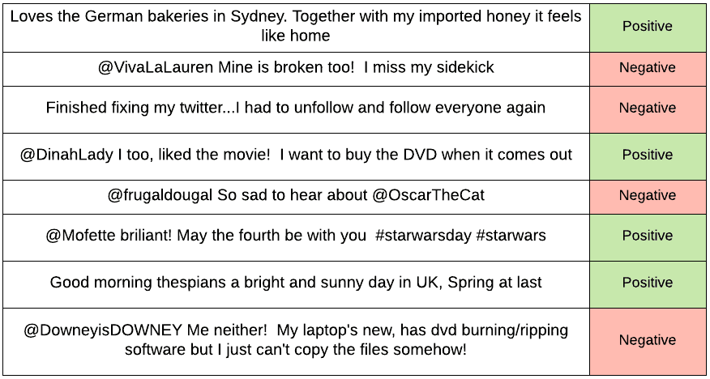
APPLICATIONS OF NLP
Sentiment Analysis

Slide 7
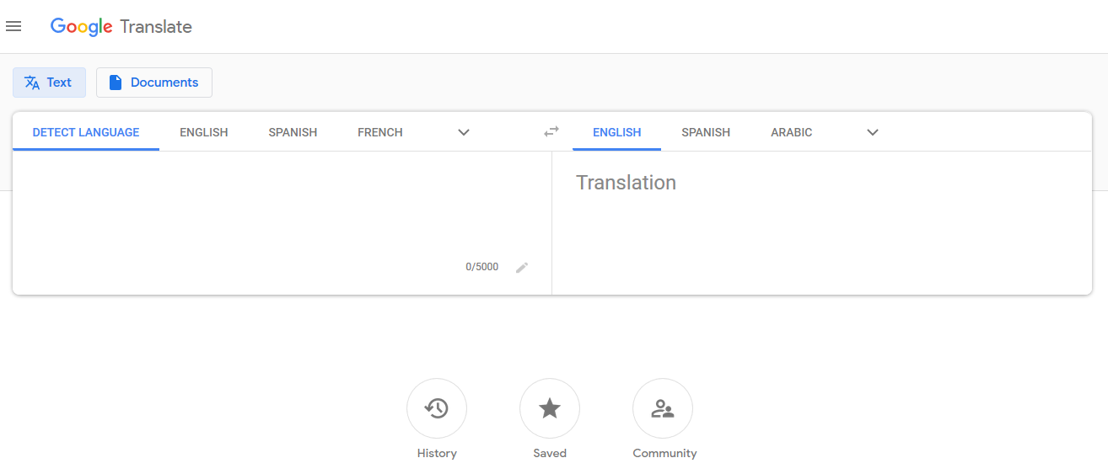
APPLICATIONS OF NLP
Machine Translation

Slide 8
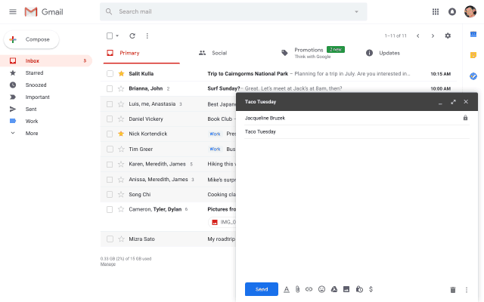
APPLICATIONS OF NLP
Text Completion/Suggestions

Slide 9

APPLICATIONS OF NLP
AI Chatbots for Q&A

Slide 10
GENERAL WORKFLOW FOR NLP
Exploratory Data Analysis (e.g. Frequency Distribution, Word Clouds)
Understand the dataset, do visualizations, form hypotheses etc.
Data Preprocessing (e.g. Lemmatization, Tokenization, Expanding Contractions, Removing Stop Words)
Why need to preprocess? Convert raw input data into more useful/understandable form for machines
Reduce noise in data
Warning: which preprocessing methods to use is debatable
Feature Engineering (e.g. Parts of Speech tagging, N-grams, TF-IDF)
Less important for deep learning methods
Model Training
Model Evaluation
Need to have quantifiable performance metrics
Error analysis → make changes to model/data
Notes:
Introduction
"NLP projects follow a structured workflow to convert raw text into actionable insights.
This involves understanding the data, cleaning it, extracting features, training models, and evaluating results."
1️⃣ Exploratory Data Analysis (EDA)
Purpose: Understand the dataset and discover patterns.
Techniques:
Frequency distribution of words
Word clouds
Basic visualizations (histograms, bar plots)
Outcome: Form hypotheses and understand common words, topics, or sentiment trends.
2️⃣ Data Preprocessing
Purpose: Convert raw text into a form that machines can understand.
Techniques:
Tokenization → split sentences into words
Lemmatization → reduce words to base forms
Expanding contractions → "don't" → "do not"
Removing stop words → eliminate common words like "the", "and"
Benefits:
Reduces noise in the data
Improves model performance
Note: Preprocessing choices are context-dependent; there is no one-size-fits-all.
3️⃣ Feature Engineering
Purpose: Convert text into numeric or structured features for modeling.
Techniques:
Part-of-speech tagging (POS)
N-grams (word sequences)
TF-IDF (term frequency-inverse document frequency)
Note: Less critical for deep learning, which can learn features automatically.
4️⃣ Model Training
Purpose: Train a machine learning or deep learning model on the features extracted.
Examples:
Sentiment analysis using Logistic Regression or LSTM
Text classification using BERT or Transformers
5️⃣ Model Evaluation
Purpose: Quantify how well the model performs.
Techniques:
Accuracy, Precision, Recall, F1-score
Confusion matrix
Error Analysis:
Examine misclassifications
Improve model by tweaking preprocessing, features, or training data

Slide 11
02
Pre-Processing

Slide 12
DATA PRE-PROCESSING
TOKENISATION
LEMMATISATION / STEMMING
BAG OF WORDS
REMOVAL OF STOP WORDS

Slide 13
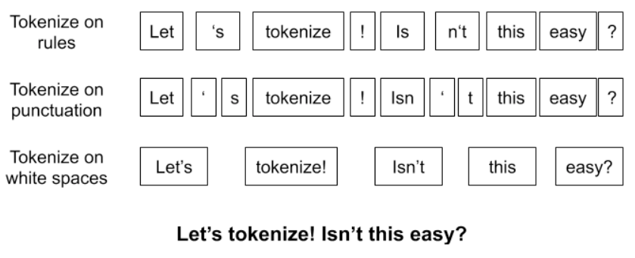
TOKENISATION
Notes:
Tokenisation is the process of breaking text into smaller units called tokens, typically words, phrases, or sentences.
For example, the sentence "The war continues despite talks." becomes tokens like ["The", "war", "continues", "despite", "talks"].
This step simplifies text for analysis by dividing it into manageable components.

Slide 14
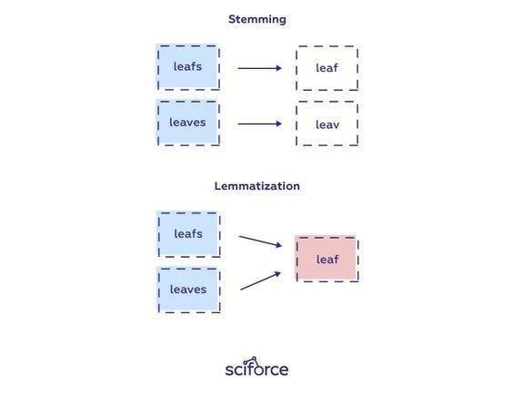
STEMMING / LEMMATISATION
Notes:
Both reduce words to their root form to treat similar words uniformly, but they differ in approach:
Stemming: A heuristic method that chops off word endings, often producing non-standard base forms.
Example: "running", "runs", "ran" → "run".
Lemmatization: A more sophisticated method that uses a vocabulary to return words to their base or dictionary form (lemma). It considers context, such as part of speech.
Example: "better" → "good" (adjective), "ran" → "run" (verb).
Lemmatization is typically more accurate but computationally expensive.

Slide 15
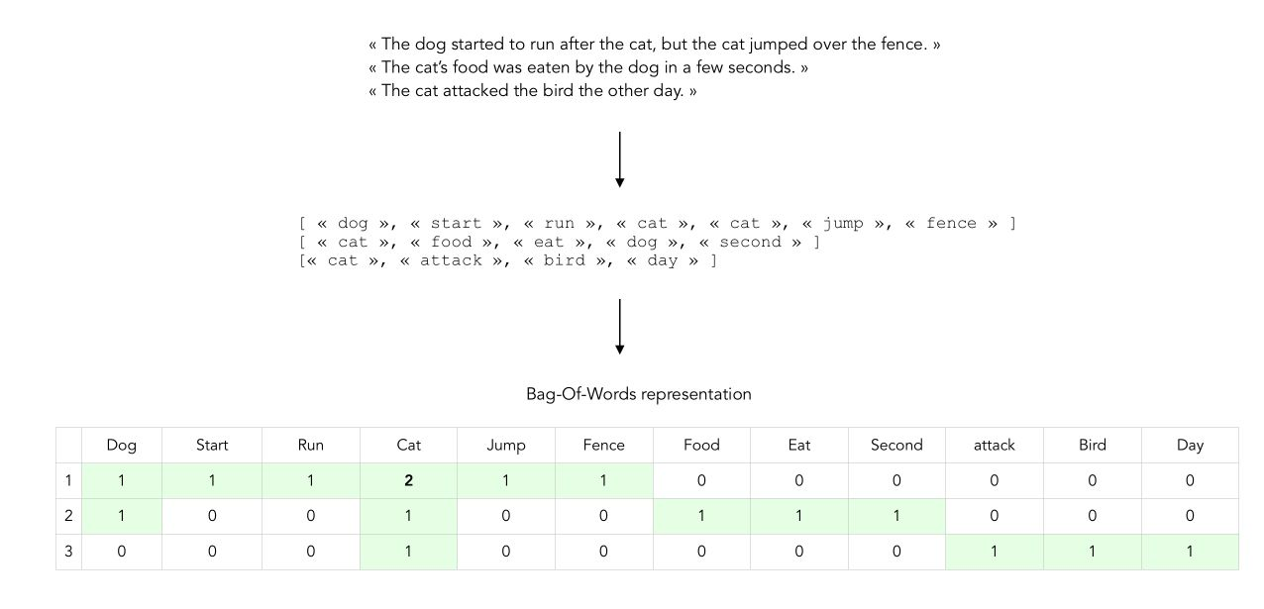
BAG OF WORDS
Also known as Count Vectoriser
Notes:
The Bag of Words model represents text as a vector of word frequencies, ignoring grammar and word order. Each unique word in a corpus becomes a feature, and the value represents its count in a given text.
For example:
Texts: "War is brutal." and "War never ends."
BoW Representation:

Slide 16
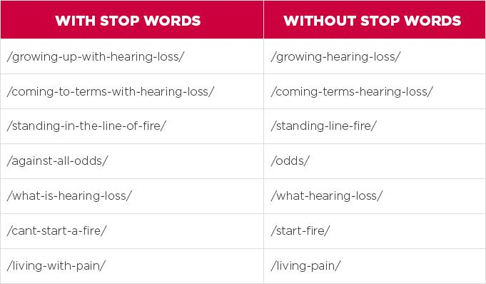
STOPWORDS
Notes:
Stopwords are common words like "and", "is", "the", which carry little meaningful information for analysis. Removing them reduces noise in the data, focusing on content words. However, their importance depends on the context of the task.
Each technique plays a key role in preparing textual data for natural language processing tasks.

Slide 17
03
Let’s Code!

